Slide 1

Putting Breast Cancer Out of Work
How to Move Our Workplaces and Our Country from Dangerous Chemicals to Safer Alternatives
Notes:
Trainer’s Prep Notes
Each person should be given a colored sheet of paper and a thick marker and told to write down one the name of one chemical they would like to replace with a safer alternative
If you’ve asked participants to bring an MSDS or SDS from their workplace, ask them to write down the name of a chemical on the sheet that they are concerned about.
On the Flip chart write instructions that give the steps of the introductory exercise
Each person should walk to the front, introduce themself by saying who they are, where they work (the workplace and the city and state, what they do at work) and name one chemical they would like to replace with a safer alternative.

Slide 2

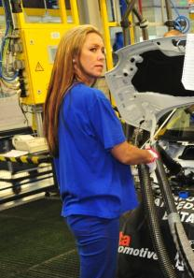

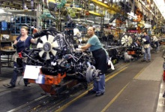
Shocking new information on breast cancer.
A November 2012 study that found that Ontario women who work manufacturing plastic automotive components and processing food are five times more likely to have breast cancer before menopause than other women living similar lives in the same communities.
Notes:
Script
So why are we talking about breast cancer at work now? The breast cancer epidemic has been going on for decades. But in November of 2012, we started getting new information about how this epidemic was linked to some of the chemicals we use at work.
(Read slide)
The words “Similar lives” is really important to understand. The control group – the Southern Ontario women who didn’t get breast cancer had made the same “lifestyle” choices – they ate and exercised in the same way, they smoked as much, they were as overweight or as stressed. The difference was where they worked and the chemicals they worked with.

Slide 3
Notes:
Script
We’re talking about breast cancer now because this disease can result from genes, environmental including workplace exposures, or a combination of both.
We’re talking about breast cancer because we can reduce our risk of the disease and other diseases by reducing environmental exposures, especially exposures in the work environment.
Of all of the breast cancer cases in the United States, about 10% are caused by genetics.

Slide 4
Notes:
Script
Only 10% of women have the breast cancer gene like Angelina Jolie.
About 25% of women who get breast cancer have a family history of it even though they don’t have the gene, (this could because a family shares a chemical or radiation exposure) and 65% of women who get breast cancer don’t have any genetic or family history.

Slide 5
Notes:
65% -- Most breast cancers have environmental causes, which is why we’re here today. We can reduce exposure to environmental causes of breast cancer.

Slide 6

Early Detection is not Prevention
Detecting breast cancer early may help treat it before it has a chance to spread, but it is not prevention.
Real prevention means eliminating causes, so that disease doesn’t have a chance to start.
We can’t change genetics, but we can change personal, environmental, and work factors
Notes:
Script:
Early detection is not prevention. Sometimes it’s called secondary prevention – it is a way to stop a disease from getting worse, once someone is already sick. Treatments can be started before a disease has spread. (see below for some answers to common questions about mammography, and encourage women – and men – to discuss with their doctors).
Preventing a disease by eliminating its causes is called primary prevention. Primary prevention means someone doesn’t get sick at all. It means all the worry, cost, and pain from treatments are eliminated. Primary prevention has the potential to reduce human suffering AND to save money spent on medical care and on lost work.
Mammography
New guidelines (as of 2009) recommended mammograms for women between 50-85. For women in this age group, the benefits outweighed the risks. This same group recommended against that routine screening mammograms women of average risk, if they are between the ages of 40-49. This was a change from prior recommendations. Women under 40, have been in this second group in past recommendations. Some of the reasons for this are that younger women have denser breasts, so problems may not show up on mammograms. In addition, there may be many false positives, which result in worry, false positives, and unnecessary medical procedures. However, women have different risk profiles, and should discuss this with their physicians.
Since young women CAN get breast cancer (although it is fairly rare), and since mammograms may miss cancers in young women, it’s important that young women trust their own bodies and seek medical advice if they are concerned about the health of their breasts. Younger women can ask about the appropriateness of mammography given their own risk, and can also ask about other screening methods, like ultrasound and MRI, that may be better at finding breast cancers in younger women.

Slide 7
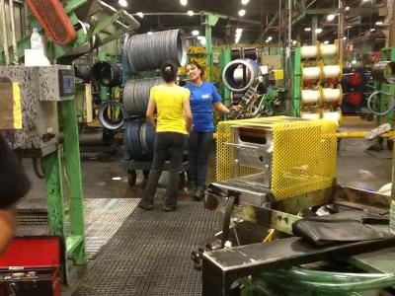
We can reduce the chemical part of the breast cancer problem
Notes:
So the USW, UAW, UFCW is partnering with the BlueGreen Alliance to Put Breast Cancer Out of Work by educating and equipping workers and their employers to prevent the harmful chemical exposures that lead to disease. We’re focusing on breast cancer but the same education and action will also help us make changes to prevent other diseases. One past example is that when the rubber industry switched from benzene-based solvents to water-based solvents, the incidence of kidney and bladder cancer in rubber workers drastically declined.

Slide 8
Putting Cancer Out of Work
How to Move Our Workplaces and Our Country from Dangerous Chemicals to Safer Alternatives
Notes:
This training is about breast cancer, but really we could be talking about putting all workplace cancers out of work.

Slide 9
Putting Infertility Out of Work
How to Move Our Workplaces and Our Country from Dangerous Chemicals to Safer Alternatives
Notes:
And workplace-related infertility in both men and women

Slide 10
Putting Diabetes Out of Work
How to Move Our Workplaces and Our Country from Dangerous Chemicals to Safer Alternatives
Notes:
And workplace related diabetes

Slide 11
Putting Birth Defects
Out of Work
How to Move Our Workplaces and Our Country from Dangerous Chemicals to Safer Alternatives
Notes:
And birth defects and other diseases and conditions.

Slide 12
Today’s Objectives
To explain the relationship between chemicals, breast cancer and other diseases.
To describe how the new science linking chemicals and human health should mean new laws and policies.
To discuss how if Congress won’t act, we need to do it ourselves and become Do It Ourselves Chemical Policy Reformers.
To familiarize ourselves with informational resources on chemicals and their effects, such as MSDS, SDS and ChemHAT.
To use these resources to identify an improvement we can make in our workplace.
Notes:
Read slide
Script
While we are focused on Putting Breast Cancer today…we continue to recognize other chronic diseases also on our OUT of WORK & Community Campaign.

Slide 13

What’s the connection between breast cancer and chemicals and other diseases?
Notes:
Script
So what’s the connection between breast cancer and chemicals and other diseases?

Slide 14
National Cancer Institute, Surveillance Epidemiology End Results Program, SEER 9
Notes:
Script
The first connection is that fewer people are dying from breast cancer and other diseases. Our country’s investment in cancer treatment is saving lives.
This slide shows that fewer women are dying from breast cancer. And that’s good news.
Since 1975, death rates (mortality) due to breast cancer have declined 30%. Most of the billions of dollars for breast cancer research go towards treatment. When resources are invested, we see results.

Slide 15
Notes:
Script
The second connection is not such good news: New cases of breast cancer (the incidence) have gone up 25% since 1975 from about 100 cases per 100,000 women to about 130 cases per 100,000 women. Incidence means new cases of breast cancer.
This is in comparison to the 30% declines in deaths from breast cancer. We see results where we make investments. And we haven’t been investing in preventing the disease from happening in the first place. Only 15% of breast cancer dollars go towards prevention research.

Slide 16

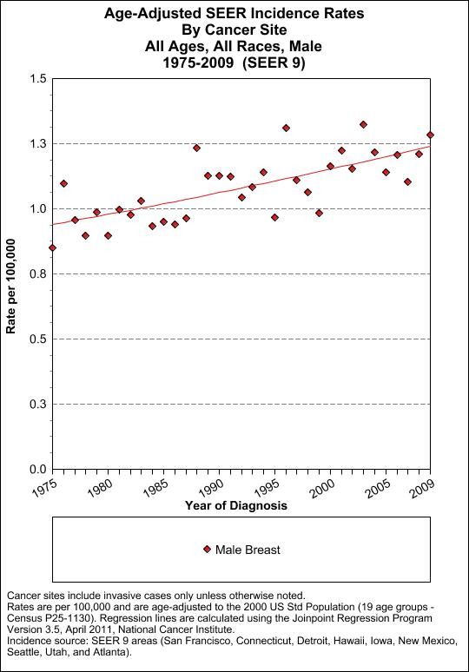
and breast cancer is increasing in men too
Notes:
Script
This isn’t just an issue for women. While breast cancer is about 100 times more common in women then men, the number of new breast cancer cases in men has risen too.
(Explanation of photo)
73 men who lived at the Marine Corps Base Camp Lejeune in Jacksonville North Carolina have been diagnosed with male breast cancer.
All of these men drank and bathed in Camp LeJeune’s tap water which contained extremely high concentrations of toxic chemicals. The chemicals found in the water include benzene, vinyl chloride and trichloroethylene (TCE), three known human carcinogens and perchloroethylene (PCE), a probable human carcinogen.

Slide 17
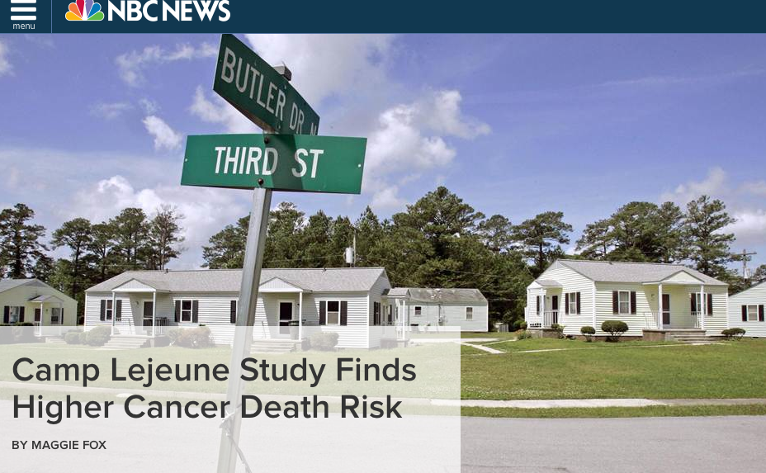

Notes:
The Camp LeJeune story also tells us more about how chemical exposures that lead to breast cancer also lead to other diseases. In February, 2014 a new study of the people who drank the contaminated water at Camp Lejeune found elevated risks of death from cancers of the kidney, liver, esophagus, cervix, multiple myeloma, Hodgkin lymphoma and ALS (amyotrophic lateral sclerosis, also known as Lou Gehrig’s disease),”

Slide 18
Small Group Exercise #1
Break into small groups
Pick a reporter
Using the small group activity method, read the fact sheet that’s been assigned to you
Prepare these questions for report back:
  What have these 5 new studies told us about breast cancer as an occupational disease?
  What can we do to prevent occupational breast cancer?
Notes:
Facilitator’s Notes
Small group activity method: Each person at each table is assigned a different factsheet (1-5) to read quietly to themselves. Then each person summarizes their factsheet for the rest of the table. The group prepares to answer the questions during the report-back.

Slide 19
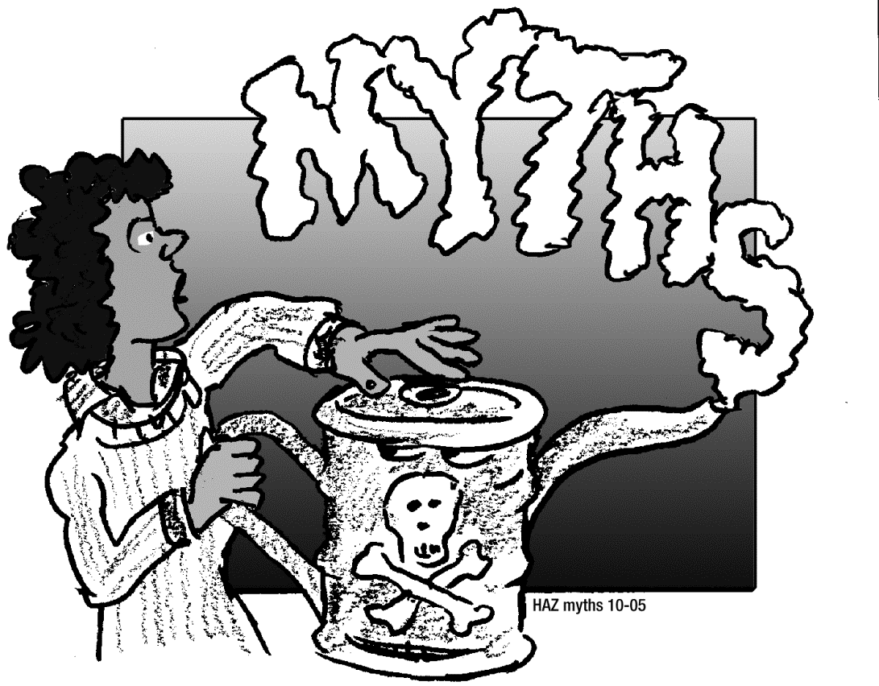
Alternative Exercise 1
Tackling Toxic Chemical Myths

Slide 20
There are at least four subtypes of breast cancer.
Luminal A
Luminal B
HER-2 positive
Basal like breast cancer (triple negative)
  Most aggressive, most difficult to treat
  Occurs most often in younger women, women with lower economic status, Black and Latina women
  Slide from the Breast Cancer Fund www,breastcancerfund.org
Notes:
Script when fact sheet three is discussed
This article is describing one type of breast cancer: There are at least four types of breast cancer. These subtypes respond to different treatments, and occur at different rates across the population
Luminal A – characterized by receptors for Estrogen and Progesterone, usually slow growing and responsive to hormonal therapies
Luminal B – similar to Luminal A, but somewhat more aggressive, and more difficult to treat
Her-2 positive – tumor cells have receptors for a protein call Her-2. This used to have a very difficult prognosis, but targeted therapies have changed this. This was possible because doctors and biologists realized this kind of cancer was unique
Triple negative breast cancer– this is the most aggressive type of breast cancer. On top of that, it is more common among younger women, women with fewer economic resources, and Black and Latina women. While women in these groups get all four subtypes of breast cancer, this type is more common in these groups.
We have learned how to treat all of the subtypes more effectively, and scientists are working hard to find better treatments for Triple Negative breast Cancer.
However, no one knows yet what causes each of these different cancers.

Slide 21
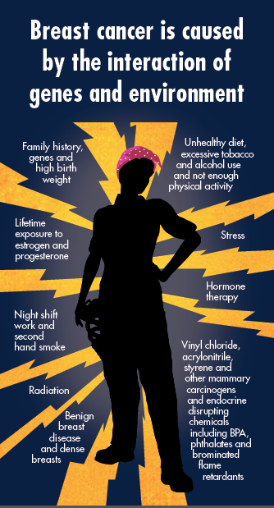
Breast Cancer and other diseases are caused by the interaction of genes and environment
Notes:
Script: Disease comes from an interaction of causes. Not one cause.

Slide 22
The Breast Cancer Resilience Scale
Strong Union
Radiation
Pregnancy
Alcohol Abuse
Happiness
Tobacco
Exercise
Night Shift
Healthy Diet
Chemicals
Genes
Breast Density
High Birth Weight
Notes:
This is another way to think about breast cancer and other chronic diseases. It’s a simple scale like a teeter-totter. Some of us are born with the fulcrum – the triangle right at the middle. Some of us may have it over to one side or the other – where our genes and our birth weight and other things we’re born with make us more or less likely to get sick. But no matter where the fulcrum is when we’re born, there are things – stressors –or weights– that make it more likely that we can stay healthy longer or more likely that we’’ll get sick. Anything we do to take the stressors off the radiation and chemicals end and put them on the strong union and healthy diet end increase the chances we can stay well.

Slide 23
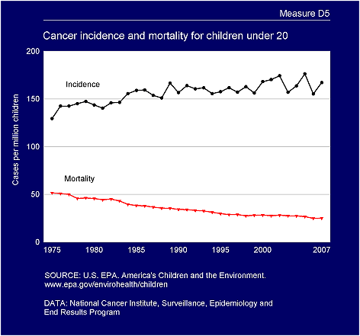
Cancer Incidence and Mortality in Children
More children are getting cancer but fewer children are dying from cancer
Notes:
Script
SO we’ve said that the breast cancer story is the same as the story of other diseases.
This slide from the US EPA’s America’s Children and the Environment report captures that same cancer story. We’ve gotten much much better at cancer treatment. When a child is diagnosed with cancer we know what therapies will keep them alive so we’re reduced the mortality rate. But our focus has been almost completely on how to keep people from dying once they get a cancer diagnosis – NOT on how to prevent them from getting cancer in the first place. That’s why the incidence rate – in this case the percentage of children that are diagnosed with cancer – keeps going up.

Slide 24
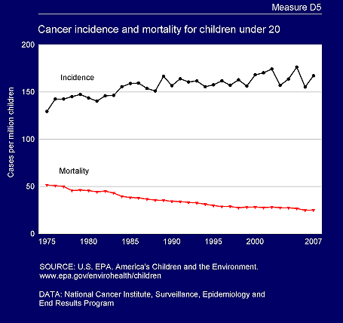
Asthma up 100% Impaired fertility up 40%
Autism diagnosis up 1000%
30% more babies are being born too early
Notes:
Script
More children are getting cancer but fewer children are dying from cancer. And the same thing is true for asthma and fertility and autism and premature birth: We know much more about how to treat these conditions but not nearly enough about how to prevent these diseases and disorders.
So we’re getting sicker but treatment is keeping us alive. But why do we think that has anything to do with chemicals?

Slide 25

The scientific understanding of how and why chemicals are making us sick has changed dramatically since the 1970s
Notes:
Script
The answer to that question comes from understanding how the science has changed since the 1970s

Slide 26
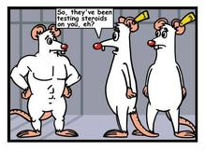
Old thinking: People aren’t animals
Notes:
Script
Back then we used to believe (and some people still do) that just because a chemical affects lab rats or animals in the wild doesn’t mean it will hurt people

Slide 27
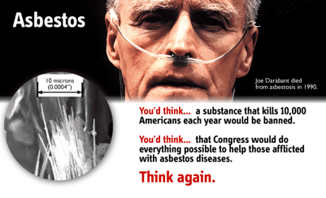
Old thinking: Unique diseases come from a single cause
Image of man with mesothelioama
Notes:
Script
We used to think that each unique chemical caused a unique disease, like how asbestos is the only chemical that causes asbestosis and mesothelioma.

Slide 28

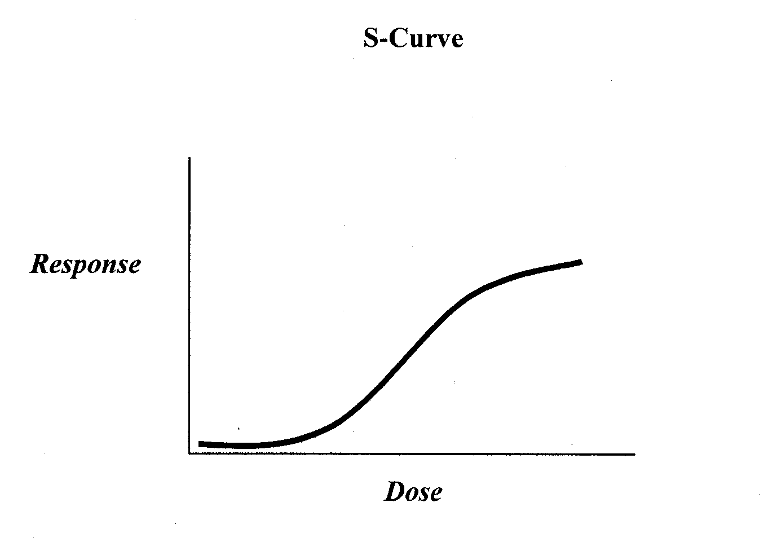
Old thinking: The dose makes the poison
Notes:
Script
This man in the funny hat -- Paracelsus – who lived from 1493-1541. He came up with the idea that “the dose makes the poison.” The modern version goes something like this, “Sure chemicals can be dangerous at very high levels of exposure– You can drown in too much water --- but as long as we limit the exposure levels to a “safe” dose, we don’t need to worry. Only big exposures matter .
Paracelsus was a revolutionary thinker in his time. While other doctors and scientists in the 1500s were still treating disease as an imbalance of bile, blood and phlegm, the guy in the red hat was realizing that exposures were making people sick, But 500 years later, Paracelsus can use a little modernizing based on new science,

Slide 29
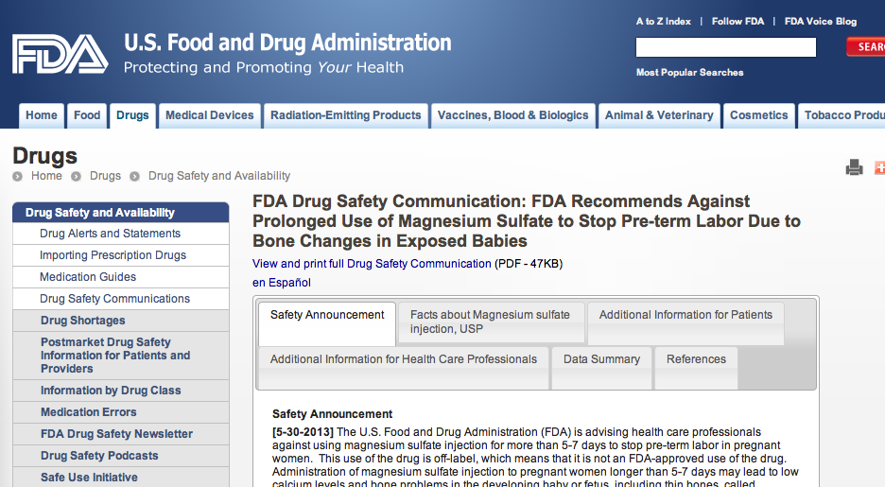
Old thinking: When the science proves cause, we make new protective policies
Notes:
Script:
And then there is logical but old and inaccurate way that Americans think about government. We think that every part of government has the same power as the FDA, the Food and Drug Administration. We like the think that if a product is unsafe, like this drug that was being used to control early labor but was causing bone changes in babies., that the scientists and officials at some agency somewhere will identify the problem and take action.

Slide 30

Old thinking: The U.S. has the most protective laws in the world
Notes:
And in the same patriotic and logical but inaccurate way, Amercans beliieve that we have the strongest and best laws to protect ourselves and our communities.

Slide 31
Small Group Exercise #2
Break into 7 small groups
Pick a reporter
Each group will be assigned a different factsheet.
Read the fact sheet that’s been assigned to you and prepare for your report-back:
  Summarize your factsheet for the group
  Answer the questions at the end of your factsheet
Notes:
Facilitator :For three other class, assign each of the 6 groups a different factsheet from numbers 6 through 11. Go through the instructions before you let the groups begin their work. For 1.5 hour class delete this slide and proceed to next slide

Slide 32

How the Reproductive Problems of Florida Panthers and American Men Connected
Notes:
For 3 hour class: Get reporter to summarize your factsheet for the group and answer the questions at the end of your factsheet
Script
So the message is that humans are animals with the same health problems from the same chemical exposures
For 1.5 hour class: Tell the story on fact sheet 6 (reprinted below)

Slide 33
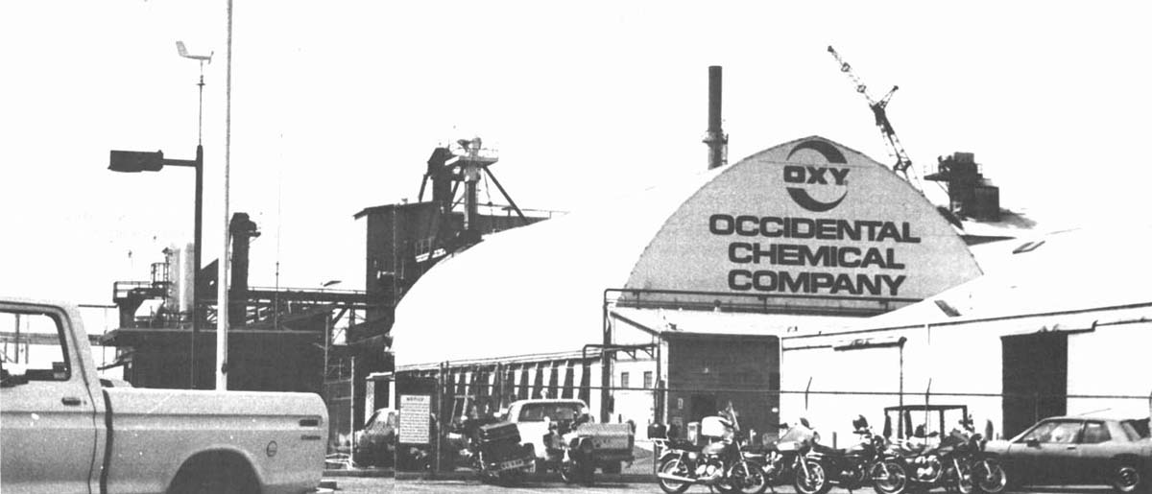

DBCP: Infertility
Notes:
The OCAW wrote an important piece of this “ animal harm is a warning of harm to humans” story.
In 1977 OCAW represented pesticide manufacturing plant workers who realized that the men in the plant were having a hard time fathering children, Their organizing lead to the recognition that an animal study on DBCP had predicted the same problem in men. (DBCP stands for Di bromo chloro propane)
Eventually the work of OCAW members led to more protective OSHA laws in California and severe restrictions on most of the uses of DBCP.
INTRO to embedded video But only after organizing overcame the industry effort to say animal studies don’t matter. Here is the Occidental Company Doctor explaining why they let workers be exposed to DBCP in spite of animal studies showing it was harmful.
DBCP/ longer story for background
Note: the following case is copyrighted and may be copied and used only by current users and owners of the textbook, BUSINESS ETHICS: CONCEPTS AND CASES by Manuel Velasquez.
For over a year, rumors had been circulating among the workers of the Occidental Chemical Plant in Lathrop, California, that the men working in their Agricultural Chemical Division were unable to have children. In June of 1977, the union asked some of their men to volunteer for semen analysis. Seven people volunteered. All had abnormally low sperm counts. Follow-up studies on five of the men on July 22 showed that they were functionally sterile. All had been involved in the production of Dibromochloropropane (DBCP).¹ News of the sterility among the workers in the Occidental plant sent shock waves through the industry. The two major producers of DBCP, Dow Chemical and Shell Chemical, were especially concerned about their workers. Subsequent tests on 432 DBCP workers in California, Colorado, and Arkansas revealed that one third had been rendered infertile by DBCP.²
DBCP is a widely used pesticide. In 1951 Dow discovered that DBCP was a highly effective soil fumigant capable of eliminating small worms that attack the root systems of corn, soybeans, grapes, citrus, peaches, figs, walnuts, pineapples, and other crops. After carrying out initial toxicology tests from 1952 to 1954, Dow concluded that, although DBCP produced slight skin irritations and was highly toxic when taken orally or when its vapors were inhaled, it could be used safely when handled carefully in well-ventilated areas. By 1957 Dow was manufacturing and selling DBCP. The labels included the following warnings:
Warning. Harmful liquid and vapor; causes skin irritation and blisters on prolonged contact; avoid breathing vapor; avoid contact with eyes, skin, and clothing; do not take internally; and use only with adequate ventilation.³
Shell started its production of DBCP in 1955 after commissioning several research studies by the University of California to determine the toxicologic properties of DBCP. These tests also showed DBCP was toxic when taken orally or inhaled but revealed "no indications of testicular effect."⁴
In 1958 Shell received a "confidential report" from a University of California researcher, Dr. Charles Hine, describing the results that inhaling DBCP had on rats. The rats were exposed to DBCP fumes in concentrations of 5, 10, 20, and 40 ppm (parts per million) five days a week for ten weeks. No rats survived 40 ppm. Subsequent autopsy showed damage to the liver, lung, kidney, brain, adrenals, and testes of the rats. "Testes decreased in size at 5 ppm, but the difference was not significant until 10 ppm."⁵ Since Shell had partially funded the study, the information was considered the confidential property of Shell.
In 1961 the results of the Shell study were combined with the results of a similar study of the effects of DBCP on rats, guinea pigs, rabbits, and monkeys that Dr. T. Torkelson had carried out for Dow. The combined study was published in 1961 in the Journal of Toxicology and Applied Pharmacology. The joint study concluded in part:
The most striking observation at autopsy [of the animal] was severe atrophy and degeneration of the testes of all species. In the rats this was characterized by degenerative changes in the seminiferous tubules, an increase in sertoli's cells, a reduction in the numbers of sperm cells, development of abnormal forms of sperm cells . . . Until further experience is obtained, close observation of the health of the people exposed to this compound should be maintained.⁶
The Torkelson-Hine study recommended that occupational exposure to DBCP be controlled to less than 1 ppm in air.
Dow and Shell submitted the results of the Torkelson study to the federal government in 1961 to obtain registration of DBCP in accordance with a new law that had been passed in 1959. After submitting the study to the federal government, Dow asked that the information be treated as a confidential trade secret and that it not be revealed to competing companies seeking to register their products.⁷ Although the study had already been published in a public journal, Dow now held that, since Dow had paid for the study, the information was proprietary and that competing companies should pay for their own registration studies.
One of the primary reasons for our efforts to protect our health and safety data as trade secret is the major competitive harm that would result from its release. We cannot afford to continue to spend millions of dollars each year on pesticides research if our data are to be made publicly available. Such release would permit our competitors, both here and abroad, to enter the market in competition with us for a fraction of the cost and with very little of the risk. . . . therefore, in order to protect our own business interests and proprietary rights, as well as the viability of the free enterprise system, we are compelled to seek judicial relief for the protection of our valuable scientific data . . . [T]he cost of registration of pesticides has become so immense that some protection of our competitive position is essential if the pesticide industry in this country is to continue its investment in the research necessary to develop safer and more effective pesticides. [Statement of Dow representative]⁸
In spite of the recommendation in the Torkelson study that workers exposed to DBCP be kept under "close observation," and in spite of the evidence of testicular damage caused by DBCP, neither Dow Chemical nor Shell Chemical carried out sperm tests on those workers involved in the production of DBCP between 1955 and 1977.
In 1961, we weren't in the habit of thinking in terms of sperm and getting these kinds of tests. In fact, even today this is a difficult problem. It is a difficult problem because of social difficulties that people may have, because of church attitudes. In no way have we been able to get a 100 percent response for sperm. [Statement of Dow representative]⁹
But why weren't the workers made aware of the results of the studies and informed that sperm tests were available to them? Couldn't workers then decide for themselves (as they did after the revelations of sterility among Occidental workers) whether to take the sperm tests or to refrain because of "church," "social," or other reasons? When asked these questions, a Dow spokesman replied as follows:
I can only surmise that in the early 1960s and late 1950s, chlorinated and brominated compounds were known to have caused a big impact on kidney and liver. This is what the doctors were monitoring for . . . But the feeling was, when . . . you look at liver, you look at spleen, and you look at heart, these, too, are organs of concern. . . . If one was to look at the medical information and go back to the historical observations of people you will find that most of the studies were done on kidney, on liver, on passage of urine, on feces, on many of these kinds of observational studies. Blood sampling and sperm tests were just not part of a routine physical examination. [Statement of Dow representative]¹⁰
The position of Shell Chemical was similar:
[Until] the recent past, industrial physicians did not consider the testes as a primary target organ, concern was for such organs as the liver, kidney, and lungs . . . Significantly, neither the 1958 nor the 1961 reports recommended explicitly doing fertility testing or measuring sperm density. They did indicate an apparent less dense sperm concentration in those animals which showed significant, discernible testicular degeneration . . . The logical conclusion was that the decreased sperm counts were secondary to the atrophy [reduction in size] of the testes. And so, the conclusion at that time by practitioners in occupational health was that if the DBCP concentration was kept within the limits recommended and that if the testicular integrity was maintained, there was no reason, given the state-of-the-art at that time, to do sperm testing on workers. [Statement of Shell Chemical representative]¹¹
The National Cancer Institute undertook studies of the possible carcinogenic effect of DBCP on rats in 1972. A large number of the rats developed stomach tumors after DBCP was orally administered. This result was published in summary abstract form in 1975 and in final form in 1977. In 1979 Hazelton Laboratories completed a study of the effects on rats of inhaling DBCP at the low-dose levels encountered in plants manufacturing DBCP. After reading a preliminary draft of the study, a scientist is reported as saying "those rats had tumors all the way up to their brains. We're going to have an outbreak of similar problems in workers, I'm pretty sure."¹²
After being informed of the sterility found among DBCP workers in the Occidental plant, Dow and Shell suspended production of DBCP in August 1977. Officials of the two companies held that the cost of protecting workers against DBCP was greater than the slim profits that could be made from its sales.¹³ First Dow (on August 25, 1977) and then Shell (August 26) announced a recall of all DBCP.
Although the federal EPA had banned all uses of DBCP shortly after the sterile workers were discovered in 1977, pressures from agricultural interests led EPA assistant director, Steven D. Jellinek, to lift the ban partially on September 19, 1978. DBCP remained illegal for use on most vegetables, but it could be manufactured and used on gardens (home gardens, golf courses, public parks), pineapples, tree fruit, grapes, and ornamental flowers so long as EPA label restrictions were followed and so long as manufacturers allowed workplace concentrations of no more than one-part-per-billion. Dow and Shell declined to resume production of DBCP, but Amvac Chemical Corporation of Los Angeles was soon producing some 2,500 gallons per day.¹⁴
The Environmental Protection Agency pointed out that if the pesticide were completely banned, farmers would suffer a $400 million loss from crop damages in the first three years of the ban.¹⁵ A citrus grower in California reported that, since 1977 when he stopped using DBCP in his 25-acre lemon grove in California, "production has gone from 1,400 boxes to 800 boxes, to less than 300 boxes."
Since Amvac found its American markets largely closed off after the ban, it decided to begin marketing DBCP more aggressively in foreign countries whose environmental laws were not as stringent as those of the United States. The decision of Dow, Shell, and later Occidental, to discontinue production of the suspected carcinogenic pesticide provided a window of opportunity for Amvac in overseas countries. In its 1979 annual report, Amvac made the following statement:
Management believes that because of the extensive publicity and notoriety that has arisen over the sterility of workers and the suspected mutagenic and carcinogenic nature of DBCP, the principal manufacturers and distributors of the product (Dow, Occidental, and Shell chemical) have, temporarily at least, decided to remove themselves from the domestic marketplace and possibly from the world marketplace . . . Notwithstanding all the publicity and notoriety surrounding DBCP it was [our] opinion that a vacuum existed in the marketplace that [we] could temporarily occupy. [We] further believed that with the addition of DBCP, sales might be sufficient to reach a profitable level.
Critics charged that Amvac was now shipping the pesticide to less developed nations whose farm workers, often illiterate, were even less knowledgeable of its dangers than American ones had been. In third world countries, they claimed, workers would apply the pesticide with their bare hands using no protective gear, unable to read warnings which were written in English anyway, and utterly unaware of the pesticide's sterilizing effects and its potentially carcinogenic nature. A former Amvac executive was quoted as replying, however, that "Quite Frankly, without DBCP, Amvac would go bankrupt."¹⁶ Moreover, defendants of the company argued, these pesticides were especially important for agrarian third world nations that desperately needed to raise their agricultural yields both to promote their development and to feed their populations. If their governments felt that the benefits of increased yields balanced the risks of their using DBCP, then this was a judgment and decision that was rightfully theirs to make.
¹U.S. Congress, Senate, Worker Safety in Pesticide Production: Hearings before the Subcommittee on Agricultural Research and General Legislation of the Committee on Agriculture, Nutrition, and Forestry, 95th Congress, 1st session, 13 and 14 December 1977, pp. 3-5.
²Ronald B. Taylor, "Pesticides," San Jose Mercury, 1 July 1979, p. 1F.
³Worker Safety in Pesticide Production, p. 120.
⁴Ibid., p. 126.
⁵Ibid., p. 126.
⁶Ibid., pp. 24, 25.
⁷Ibid., p. 28.
⁸Ibid., p. 28.
⁹Ibid., p. 24.
¹⁰Ibid., pp. 24, 25, 26.
¹¹Ibid., p. 32.
¹²Taylor, "Pesticides."
¹³Ibid.
¹⁴Ibid., p. 2F.
¹⁵Ibid., p. 1F.
¹⁶David Weir and Mark Schapiro, Circle of Poison (San Francisco, CA: Institute for Food and Development Policy, 1981), p. 22.

Slide 34
Old thinking: People aren’t animals
FALSE
Notes:
We used to think that just because a chemical affects lab rats or animals in the wild doesn’t mean it will hurt people. But now we understand that animal studies are a warning of what can happen to us.

Slide 35
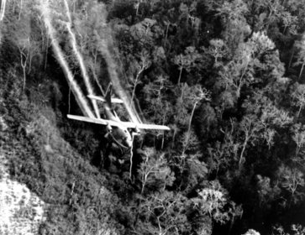
What we learned from an Uncontrolled Experiment on American Soldiers and the People of Southeast Asia?
Notes:
For 3 hour class: Get reporter to summarize your factsheet for the group and answer the questions at the end of your factsheet
Script: From this story we learn that: Most chemicals don’t work like asbestos– giving people one disease they
can’t get any other way.
For 1.5 hour class tell the story on fact sheet 7 reprinted below
From 1962 to 1971, the U.S. military sprayed 19 million gallons of Agent Orange and other chemicals on the forests of Vietnam, Cambodia and Laos. These chemicals were used as an herbicide - a plant-killer – to remove the jungle canopy of foliage and to destroy crops that could benefit the armies the U.S. was fighting.
American soldiers serving in Southeast Asia and the people of Viet Nam, Cambodia and Laos were exposed to these chemicals when they were sprayed. Many exposed people got a skin rash called chloracne. At that time, military doctors told their patients that this type of acne would be the only problem they would have from their Agent Orange exposure.
Now health professionals and research scientists know that information was terribly wrong. But they learned that from the suffering and the organizing of Vietnam Veterans and their families. When Vietnam veterans their families and their doctors got organized to draw attention to the health problems they believed were connected to military service, Congress passed the Agent Orange Act of 1991. The legislation mandated the national Institute of Medicine to evaluate the scientific and medical information on the health effects of exposure to Agent Orange and other herbicides used in Vietnam every two years and report their findings to the Veterans Administration so compensation and treatment can be provided. No other chemical receives this kind of comprehensive and consistent review.
Because the law requires that scientists look for the evidence, Vietnam veterans who were exposed to Agent Orange can be compensated for one kind of leukemia, two kinds of lymphoma (Hodgkin’s Disease, non Hodgkin’s lymphoma) other kinds of cancer as well as diabetes, a type of heart disease and Parkinson’s disease. The VA also compensates when the child of a Vietnam veteran is born with the birth defect called spina bifida that results in incomplete closing of the spine.
The story of Agent Orange shows how one chemical we were told was safe can cause many diseases many years after exposure, including in children born decades later.

Slide 36


Hodgkin’s Disease, non Hodgkin’s lymphoma, Prostate Cancer, Chronic B-cell Leukemia, Respiratory Cancers,
Type 2 Diabetes, Ischemic Heart Disease, Parkinson’s Disease
Notes:
These are some of the diseases that are applicable for compensation.

Slide 37
Old thinking: Unique diseases come from a single cause
FALSE
Image of man with mesothelioama
Notes:
We used to think that each unique chemical caused a unique disease, like how asbestos is the only chemical that causes mesothelioma. The Agent Orange story teaches us that one chemical can cause many different diseases.

Slide 38
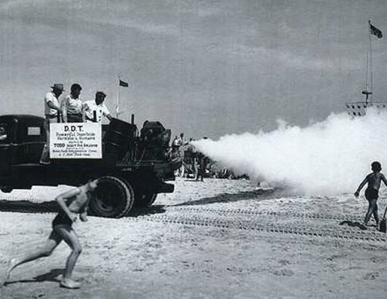
Breast Cancer and DDT: Sometimes Timing Matters More Than Dose
Notes:
For 3 hour class: Get reporter to summarize your factsheet for the group and answer the questions at the end of your factsheet
Script: Bottom line: Sometimes when you are exposed matters much more than how much exposure you got.
For 1.5 hour class, tell the story on fact sheet 8, reprinted below
Women in some parts of the United States are more likely to be diagnosed with breast cancer. One of these places is Long Island, New York. In 1993, the higher-than-average breast cancer rates lead the federal government’s National Cancer Institute to sponsor 10 breast cancer studies of Long Islanders.
One of those studies looked at the link between DDT and breast cancer. Between the 1940s and the 1970s, DDT was routinely sprayed across Long Island to control mosquitoes.
The study looked at the DDT levels of women who had breast cancer. Then researchers compared those levels to the amount of DDT in the blood of a similar cross section of adult women who did not have breast cancer. The study found that there was no link between the amount of DDT in and the incidence of breast cancer in the adult women who were studied. So scientists declared that DDT does not raise the risk of breast cancer.
Fourteen years later, in 2007, a study was published that also compared DDT in women who had breast cancer and women who did not. But this time researchers used stored blood to measure how much DDT women had in them when they were girls going through the breast development of adolescence. This study showed that women who are exposed to higher levels of DDT before their breasts are fully developed are five times more likely to develop breast cancer: Put in an other way, the timing of the dose mattered much more than the dose itself.

Slide 39

Notes:
Actual advertisement for DDT

Slide 40
Old thinking: The dose makes the poison
FALSE
Notes:
Script: Now we understand that than man in the red hat had it wrong. That sometimes timing matters more than dose.

Slide 41
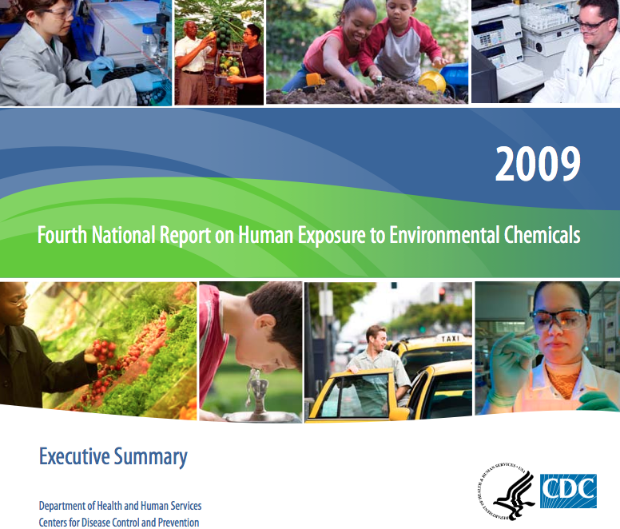
Biomonitoring tells us that we all are being exposed to toxic chemicals
Notes:
For 3 hour class: Get reporter to summarize your factsheet for the group and answer the questions at the end of your factsheet
Script:
And from this fact sheet we learn that everybody, even babies still developing in their mothers, are being exposed to toxic chemicals.
For 1.5 hour class, tell the story on fact sheet 9, reprinted below
At the end of the 1990s, the federal Centers for Disease Control and Prevention (CDC) started measuring chemicals in people. The CDC’s National Biomonitoring Program specializes in “the direct assessment of people's exposure to chemicals by measuring the chemicals or their breakdown products (metabolites) in blood or urine.”
Every few years, the CDC issues an updated report on the biomonitoring of environmental chemicals in a representative cross sample of the American people. Environmental organizations have supplemented the work of the CDC by doing their own biomonitoring testing:
Here’s some of what they’ve found:
Everyone’s contaminated with industrial chemicals. Chemicals in our food, air, water and the products we use every day add to the exposure that some people get from their workplace. Hundreds of substances have been identified in people’s blood and urine. Babies are being born pre-contaminated,
The Environmental Working Group has tested the cord blood of newborn babies and found lead. Mercury, PFCs like Teflon, PBDE and other flame retardant chemicals, PCBs, dioxin, BPA and perchlorate from rocket fuel.
The chemical industry says that the presence of tiny amounts of toxic chemicals in our bodies doesn’t mean we’re being harmed. But tiny amounts of some chemicals can have enormous impacts.
BPA is a good example of this type of chemical. BPA is short for Bisphenol A, a component of epoxy resins and polycarbonate plastics. The CDC has found BPA in more than 90% of Americans and EWG found it in 9 out of 10 of the cord blood samples of newborn babies. Hundreds of animal studies and some human evidence have lead the U.S. National Toxicology Program (NTP) to issue the warning that BPA may pose risks to human reproduction.
Bisphenol A creates this risk by fooling our bodies into thinking that it is one of the hormones we need to grow and develop. Understanding how tiny amounts of hormones work is essential to understanding why extremely small amounts of chemicals that act like hormones can be a problem.

Slide 42

Mother’s Lips
Father’s Color Hair
Chemical
Industry’s
lead, mercury, PFCs, PBDE, PCBs, dioxin, BPA and perchlorates
Notes:
Studies have shown that babies are born with up to 300 industrial chemicals in their blood.

Slide 43

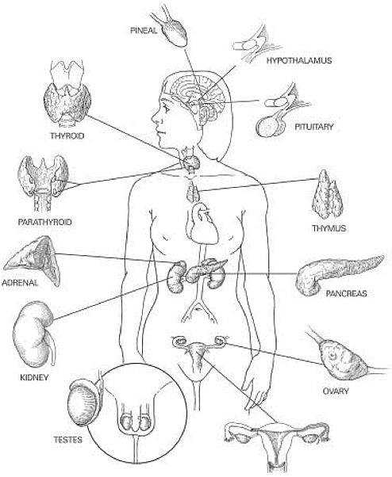
Two Ways to Make Hormones
Phthalates, Bisphenol A, Perfluorinated Compounds, Cadmium, DDT, Dioxin
Estrogen, Testosterone, Insulin, Progesterone, Thyroxine and others

Slide 44
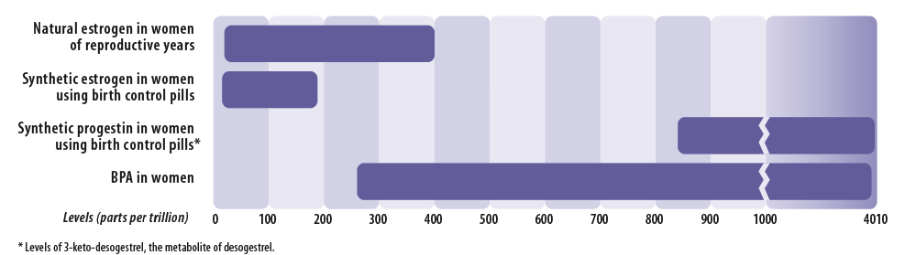

Hormones: Tiny doses control communication and coordination of body tissues
300 ppt in a 143 lb. woman
is equivalent to .000000000002
of one plain M &M candy
Notes:
Starting with the formation of eggs and sperm and the meeting of the two in conception, growth and development are regulated by tiny amounts of our bodies’ natural chemicals called hormones. We manufacture these chemical messengers, which enter our bloodstream and travel throughout our systems, managing our metabolism and controlling the function of our organs. Hormones produce a wide variety of regulatory signals to speed up our heart rate or release an egg from the ovary at part per billion levels in the blood. That’s why we have to be concerned about tiny exposures to industrial chemicals that act like hormones when they get into our bodies.
The top of this slide shows how the amount of BPA – a chemical that acts like estrogen – is about the same as the amount of estrogen that makes a woman fertile. These are tiny amounts – two trillionths of a gram in a 143 pound woman – but these tiny amounts are what is needed to make a woman fertile or to interfere with a woman or a man;s normal hormone levels.

Slide 45
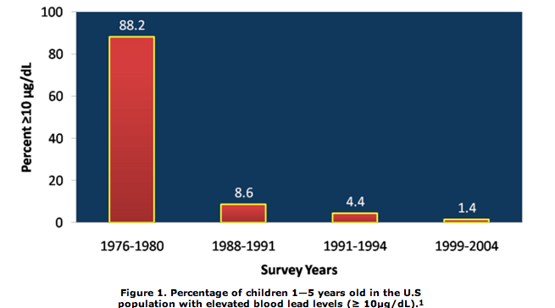
From the CDC’s 2009 Fourth National Report on Human Exposure to Environmental Chemicals
Notes:
Script: No matter how it gets into us biomonitoring shows us what those levels are: And biomonitoring has also brought us good news: Law that removed lead from paint and gasoline has taken the lead out of American children. This chart shows how those changes drastically reduced the number of children with elevated blood lead levels from nearly 9 out of 10 children to just over 1 out of ten children.

Slide 46
Old thinking: The dose makes the poison
FALSE
Notes:
Script: Now we understand that than man in the red hat had it wrong. Sometimes small amounts matter a lot if those chemicals act like hormones.

Slide 47
I need to wake up
to the 21st Century. It’s not just dose that matters. There’s also timing, and chemicals that act like hormones at low doses, long delays between exposure and disease and so much more
Notes:
Script: And if Paraselsus was alive today he’d be saying: (read slide)

Slide 48
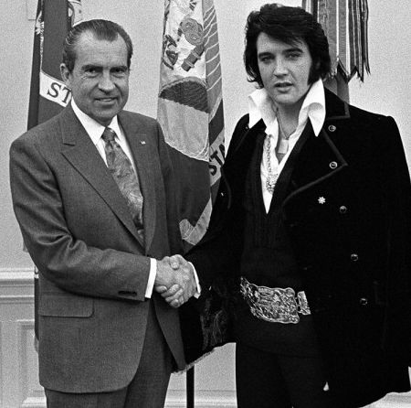
Our occupational safety and health and chemical management laws lost in the 1970s
Notes:
For 3 hour class: Get reporter to summarize your factsheet for the group and answer the questions at the end of your factsheet
three hour class script: And from this story we learn that our Occupational Safety and Health Act are old so out of date they are not as effective as they need to be.
For 1.5 hour class: summarize the #10 fact sheet reprinted here:
Factsheet 10: How Are Our Occupational Safety and Health Laws Kept From Keeping Up With the Science
Excerpts from Remarks by Dr. David Michaels , Assistant Secretary of Labor for Occupational Safety and Health
Public Citizen 40th Anniversary Speakers Series, January 18, 2011
Four decades after the signing of the Act, OSHA is making a difference in the lives of millions of workers. Worker deaths in America are down — from perhaps 14,000 in 1970 to 4,400 in 2009 — in a workforce that has doubled in size. Injuries and illnesses are down — from 10.9 incidents per 100 workers in 1972 to less than 4 per 100 in 2009.
Some of this decline was due to the shift of our economy from manufacturing to service industries. But, clearly, much of our progress is due to tougher government standards and greater awareness of workplace safety practices brought about by OSHA.
Since we began, worker exposure to asbestos, lead and benzene have been dramatically reduced, and in the last decade new standards have helped shield healthcare workers from needlestick hazards and bloodborne pathogens. The clear impact of OSHA can be seen on a daily basis.
Still: While worker deaths, injuries and illnesses are far lower today than 40 years ago; they're not low enough. This country's conscience was rocked recently with the death of 11 workers on the Deepwater Horizon oil platform. Yet 12 workers are killed on the job every single day in this country. If a Deepwater Horizon or a Sago-like disaster was reported in the news every day, there would be a public outcry. But because these 4,400 deaths a year usually happen one at a time, in towns large and small all across the country, they rarely make headlines. Even less noted are the 4 million more who suffer a serious job-related injury, and tens of thousands more suffer from serious job-related illnesses. What's most important, most of these deaths and injuries are preventable - preventable by basic safety precautions such as providing a safety harness and line to prevent workers from falling off a roof, shoring up a trench to make sure it doesn't collapse, or guarding a machine so a worker doesn't get his hand cut off.
Federal OSHA has only around 1,200 inspectors to cover 29 states. OSHA funded state plans have around the same, so there are less than 2,500 inspectors to cover 7.5 million workplaces employing more than 130 million workers. The maximum fine for a serious violation is $7,000 — a small fraction of those imposed by other federal agencies. By comparison, the top penalty for violating the South Pacific Tuna Act is $350,000.
Similarly, the maximum criminal penalty for a worker death associated with a willful violation of an OSHA standard is a misdemeanor with up to six months in jail; yet harassing a wild burro on federal land is a felony with a sentence of up to a year. In 2001 at a Delaware oil refinery, a tank of sulfuric acid exploded, killing a worker named Jeff Davis. His body literally dissolved in the acid. The OSHA penalty was only $175,000. Yet, in the same incident, the death of thousands of fish and crabs led to an EPA Clean Water Act citation of $10 million. How can we tell Jeff Davis' wife and his five children that the penalty for killing fish and crabs is many times higher than the penalty for killing their husband and father?

Slide 49
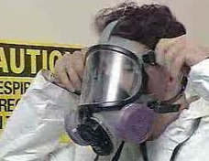
OSHA is Out of Date
40 Years
of OSHA
80,000 Chemicals
16 Permissible Exposure Limits (PELs)
Notes:
Script:
OSHA’s Permissible Exposure Limits (PELs) are one good example of how out of date our laws are:
While 80,000 chemicals are on the market
OSHA has only done 16 PELs that were all created in the 1970s using 1950s science.
Science has improved and rulemaking has become much more complicated.

Slide 50
Current OSHA Penalties | Are Too Low
Maximum penalty for a serious OSHA violation | $ 7,000
Maximum penalty for willful and repeated violation | $ 70,000
Maximum USDA penalty if dairy company doesn’t pay milk advertising fees | $ 130,000
Maximum FCC fine for broadcasting indecent content | $ 325,000
Notes:
Script:
The penalties that OSHA assesses for violations of the law are too low.

Slide 51
Old thinking: When the science proves cause, we make new protective policies
FALSE
Notes:
Americans think that every part of government has the same power as the FDA, the Food and Drug Administration. We like the think that if a product is unsafe, like this drug that was being used to control early labor but was causing bone changes in babies., that the scientists and officials at some agency somewhere will identify the problem and take action. That should be true but sadly it is not true.

Slide 52

TSCA is less protective than laws in Europe and Japan
Notes:
For 3 hour class: Get reporter to summarize your factsheet for the group and answer the questions at the end of your factsheet
Script: and to summarize the protections against toxic chemicals in the US are much weaker than those in other parts of the world.
For 1.5 hour class summarize the story on fact sheet 11 reprinted below
How Are Our Chemical Management Laws Prevented from Keeping Up With the Science
Formaldehyde is that smell you may remember from the tubs of preserved specimens in the high school biology lab. The chemical is also used to make chemicals and resins and as an adhesive in plywood and particleboard.
Formaldehyde is one of the 62,000 chemicals that were grandfathered in when TSCA became law with no requirement that it be tested and shown to be safe. Since 1976, new science has shown that formaldehyde can cause cancer, asthma attacks and other breathing problems. It is also suspected of harming the nervous and immune systems.
Because of these health impacts, China makes low formaldehyde plywood for domestic use and to export to the European Union and Japan. But China makes plywood with high levels of formaldehyde for export to the United States. This plywood was used in the trailers that FEMA, the Federal Emergency Management Agency, supplied to Hurricane Katrina survivors and to the emergency workers cleaning up the BP oil spill in the Gulf of Mexico. After Katrina survivors started getting sick from the formaldehyde fumes, the U.S. Environmental Protection Agency (EPA) was petitioned to regulate this use of formaldehyde.
EPA denied the petition because the agency said it doesn’t have sufficient legal authority to take action against formaldehyde under TSCA.
The problems with formaldehyde aren’t limited to FEMA trailers. Many building materials and other consumer products used in the United States have dangerous levels of formaldehyde. An Arizona study designed to be representative of the general U.S. population found that the air in 25% of homes had dangerous levels of formaldehyde.
Former EPA Administrator Lisa Jackson inherited these problems with TSCA. Administrator Jackson went to Congress to ask for TSCA reform and ordered her agency to do what it can to act on formaldehyde and other chemicals of concern. But when the EPA tried to finalize its assessment of formaldehyde under its IRIS program, the Formaldehyde Council went to their friends in Congress to stop the agency from taking action.

Slide 53

David and Julia Koch

Slide 54
The Toxic Substances Control Act (TSCA)
80,000 different chemicals have been produced and used since TSCA became law in 1976.
62,000 of these chemicals were grandfathered in when TSCA became law with no requirement that they be tested and shown to be safe.
In the 37 years that TSCA has been the federal law on chemicals, EPA has required testing on just 200 chemicals.
When EPA was prevented from using TSCA to restrict asbestos 23 years ago, it gave up trying.
Notes:
Facilitators Notes: Review information on slide:
Script
EPA spent 10 years and $10 million trying to ban asbestos. Their ban was overturned in the courts.
ASK: Do you remember what you were doing in 1976?

Slide 55
Old thinking: The U.S. has the most protective laws in the world
FALSE
Notes:
Script: So sadly, the US is lagging behind Europe and Japan and Korea and Canada in protecting its citizens against toxic chemicals

Slide 56

More than 40,000 Americans die prematurely each year from exposure to toxic substances at work — 10 times as many as those who die from occupational injuries
Notes:
Script: To sum up: Our laws are based on 14th century ideas of how chemicals work, 1960s understanding about “permissible exposure limits” and and 1970s thinking about regulation and fines. The result is 40,000 premature deaths and 190,000 illnesses every year that are related to chemical exposures.

Slide 57
How do we act on the new science with or without Congress?
How can we join the Do It Ourselves Chemical Policy Reformers?
Notes:
SO what do we do?

Slide 58

Will she be the one in eight that gets breast cancer?
Notes:
Facilitators Notes (scroll through this set of little girl slides backwards and forwards to make the point)
Script:
Here’s the opportunity: We can’t control every risk factor that might give this little girl breast cancer.

Slide 59

“…genetic and environmental factors individually contribute and interact with each other to increase breast cancer risk.”
Breast Cancer and the Environment:
Prioritizing Prevention
Notes:
But we don’t need to. Since breast cancer comes from an interaction of factors:

Slide 60

Family history
Genes
High birth weight
Dense breasts

Slide 61

Lifetime exposure to estrogen and progesterone

Slide 62

Unhealthy diet and excessive tobacco and alcohol use

Slide 63

Night shift work
Second hand smoke
Radiation

Slide 64

Vinyl chloride
Acrylonitrile
Styrene
BPA
Phthalates Brominated flame retardants
Notes:
If we can reduce the chemical risk factors (scroll backwards) we can reduce cancer risk

Slide 65
Fake leather vinyl backpack
Acrylic sweater
Polystyrene food container
BPA lined food cans Phthalates in personal care products
Flame retardants in foam, electronics and fabric
Notes:
If we can get these chemicals linked to breast cancer out of the products this child uses and our members make, we can reduce her breast cancer risk

Slide 66
REDUCE THE CHANCE OF BREAST CANCER BY:
Eliminating exposure to chemical hazards
Notes:
Take more out of the back pack!

Slide 67
Genetics and the environment will still be a factor but by reducing the chemical risk factors, we can reduce the cancer risk.

Slide 68
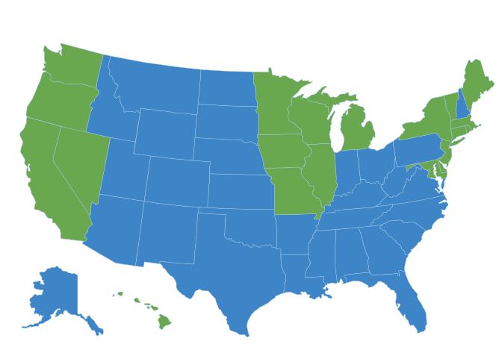
20 States have passed 100 laws restricting chemicals
States in green have passed one or more laws
Notes:
Script:
The states have been leaders in do it ourselves chemical policy reform. Twenty states have passed about 100 laws to restrict the use of chemicals. Here are some recent wins on chemical policy:

Slide 69
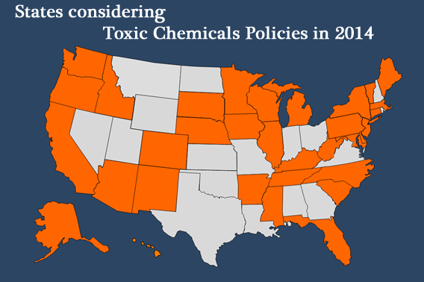
Notes:
And this year, legislatures in 33 states will be considering more do-it-ourselves chemical policies
Note:
For specific information about what’s happening in the states go to
http://www.saferstates.com/2014/02/2014-toxic-chemicals-legislation.html

Slide 70

GreenScreen for Safer
Chemicals
helping companies, workers and product designers find and use safer chemicals
Notes:
More and more companies are using chemical management tools like the Green Screen that take what we know about chemicals

Slide 71
The 4 GreenScreen Benchmarks
All chemicals can be assessed for their hazards and put into one of four benchmarks
Identifies High
Hazard Chemicals
Notes:
And divide them into four groups
Chemicals are put into 4 categories using Benchmarks
1= worst; 4 = best

Slide 72
GreenScreen Benchmarking
Benchmark 1 identifies chemicals of high concern (carcinogens, hormone disrupting chemicals, chemicals that cause birth defects, etc…
Notes:
Script: The 1s are chemicals of high concern that you would want to potentially eliminate from your processes and emissions.

Slide 73

Moving away from hazardous chemicals - yes! But how can companies avoid using substitutes that are equally hazardous?
73
Notes:
Script:
The Green Screen is designed to face the challenges that
Replacements may be as bad or worse for environment or human health and that it can be complicated to find the best substitutes

Slide 74
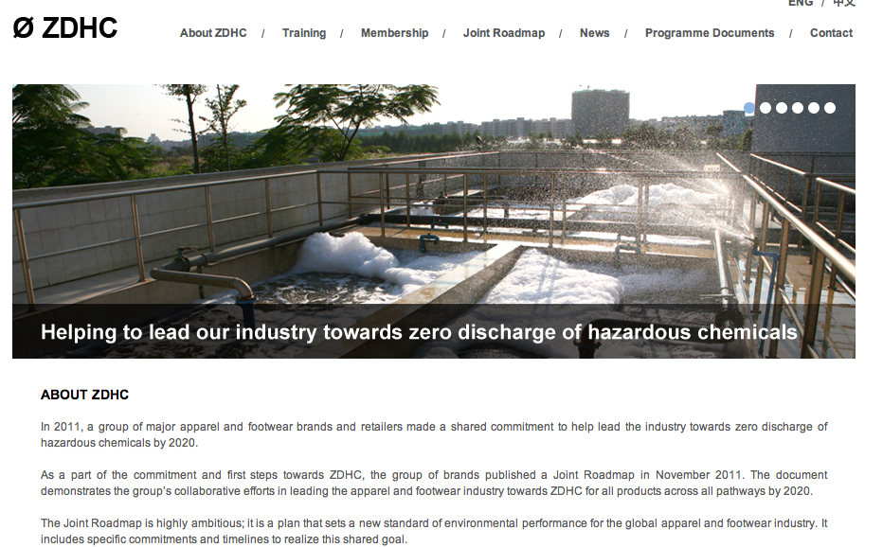


Notes:
Companies like Adidas and Levi Strauss and the Gap are using the Green Screen to tell their suppliers “stop using red benchmark one chemicals and don’t replace them with other red chemicals. Try to find greener chemicals instead.

Slide 75

GreenScreen for Safer Chemicals
Companies can demand suppliers only use ingredients that are Benchmark 2 or higher to ensure substitutes are not another carcinogen or chemical of high concern
This what Hewlett-Packard demands from their plastics suppliers for cables
Notes:
Facilitator notes (read or summarize slide)

Slide 76

Notes:
Even Walmart, ((!!!!#&@*) WALMART is adopting a safer chemicals system

Slide 77
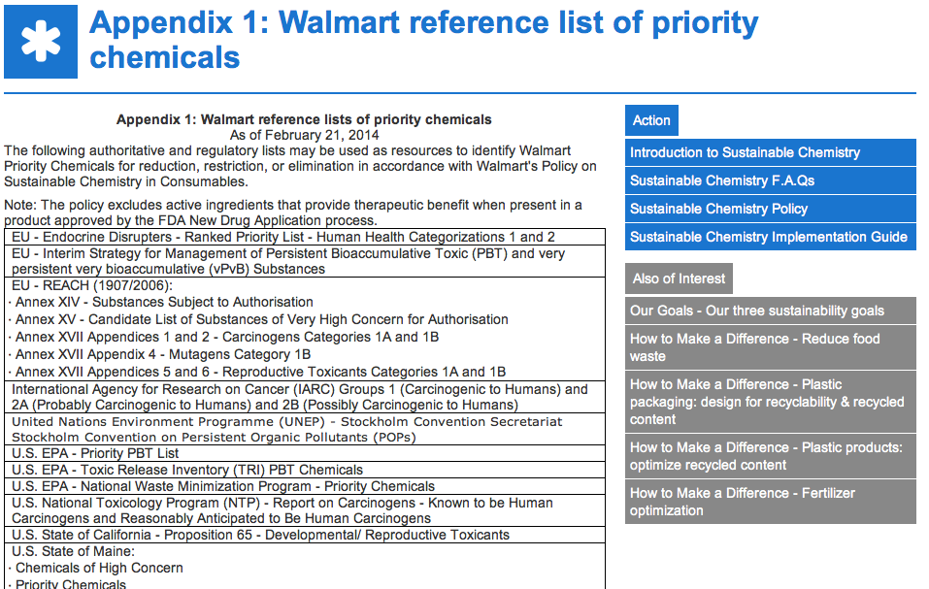
Notes:
Walmart has just issued an implementation guide for how their suppliers should be moving away from chemicals of concern – a long list of all of the chemicals that government agencies around the world have determined our dangerous. We call this group of government agencies – authoritative bodies.

Slide 78
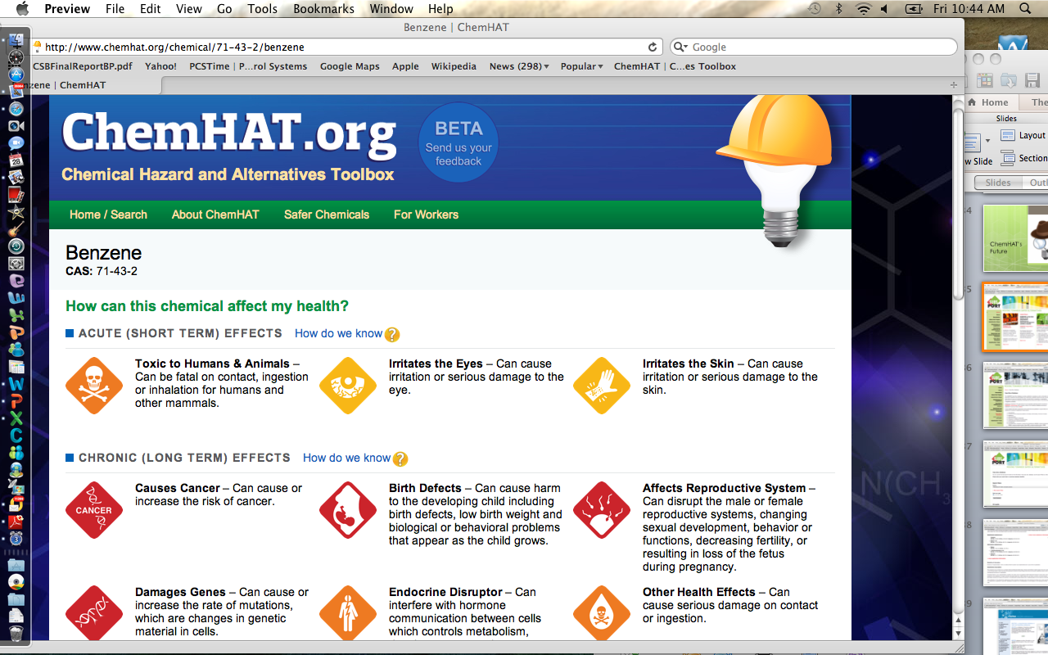
Notes:
Script: ChemHAT, the database designed by and for workers, gives you information about the health hazards of chemicals and the availability of safer alternatives. It is based on a similar list of authoritative lists that Walmart is using, So, pretty much, if a chemical has red or orange icons on ChemHAT, Walmart wants its suppliers to replace it with safer chemicals,
Facilitators notes
Note that you will see the lightbulb and hardhat when ChemHat is referred to.
Located at: ChemHAT.org
(Information available: Icons like the playing cards you used
How can it affect my health:
Breast Cancer Icon and many others
Inherent hazards (flammable/restricted list)
Safer alternatives?

Slide 79
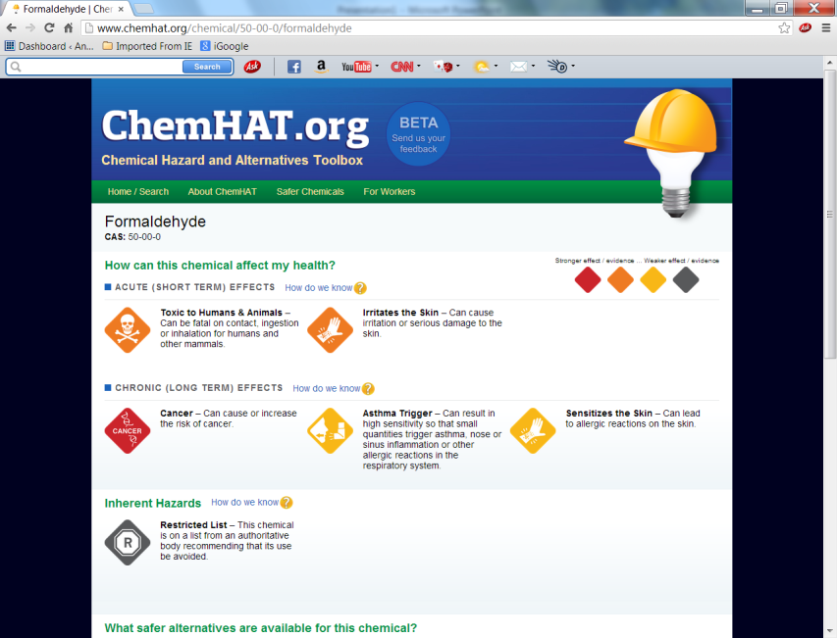
Notes:
Script:
Here’s an example of the ChemHAT search results for formaldehyde, showing all of the toxic effects of the chemical.

Slide 80
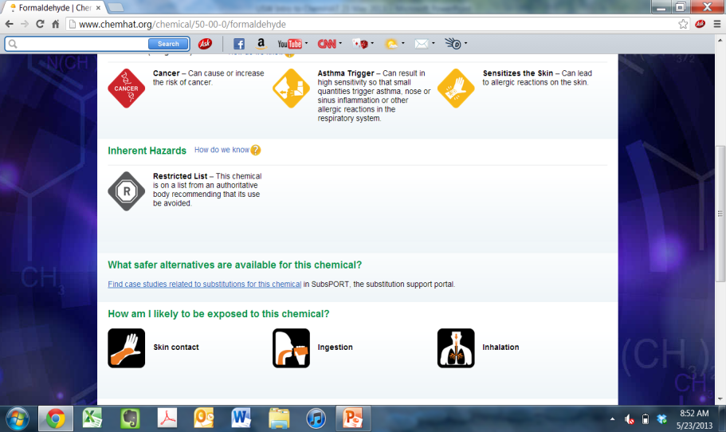
Notes:
Script:
And when you scroll down you see the possible routes of exposure

Slide 81
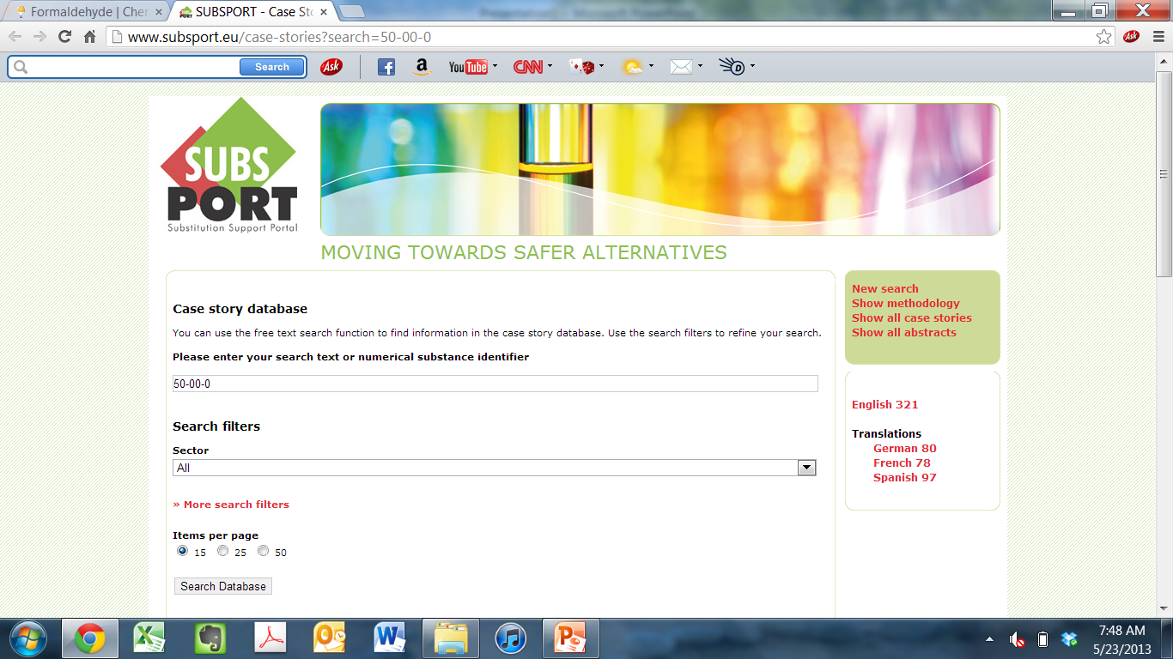
Notes:
Script: And when you scroll down more If there is information on alternatives in ChemHAT, you’ll be taken directly to SubsPORT, which is a collection of substitution case studies and safer alternatives. This is the part of ChemHAT that we are now working to expand.

Slide 82
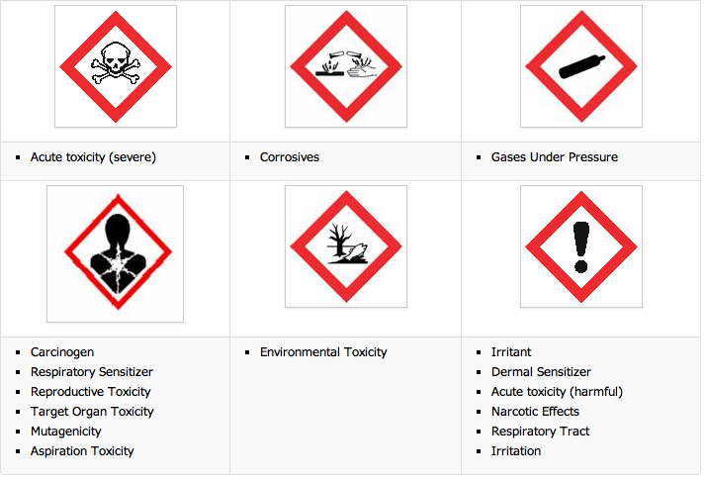
The Globally Harmonized System of Classification
and Labeling of Chemicals
Notes:
ChemHAT is designed to build on the information that is part of the new Globally Harmonized System of Classification and Labeling of Chemicals usually referred to as GHS. GHS groups all chronic health problems under the exploding chest pictogram. (Cancer and infertility get the same pictogram).
More information on GHS if you need it:
OSHA adopted GHS as a revision to its Hazard Communication Standard in 2012.. There is a transition period to implement GHS gradually between 2012 and June 2016.
The old Hazard Communication standard allowed chemical manufacturers and importers to convey hazard information on labels and material safety data sheets in any format they chose. The revised standard uses GHS hazard phrases and has a single set of criteria for classifying chemicals according to their health and physical hazards. It also specifies elements for communicating hazards through labels and safety data sheets.
GHS changes to the Hazard Communication Standard
There are four major changes to the Hazard Communication standard:
Hazard classification - Chemical manufacturers and importers are still required to determine the hazards of the chemicals they produce or import. Under the revision, health and physical hazard classification determinations are now made using standard specific criteria. Not all health hazards are covered under GHS including chemicals that are toxic to the brain and nervous system.
Labels - Chemical manufacturers and importers are now required to provide a label that includes a signal word, pictogram, hazard statement, and precautionary statement for each hazard class and category.
Safety Data Sheets (SDS) - These will replace material safety data sheets (MSDS) and now have a format with 16 specific sections to ensure consistency in presenting important hazard and protection information.
Information and training - The revision requires employers to provide workers with training on the new label elements and safety data sheet format in addition to the current Hazard Communication Standard training requirements by December 1, 2013.

Slide 83
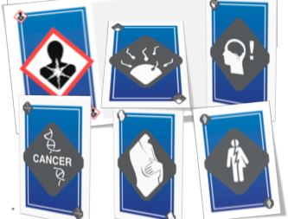
ChemHAT will give you more information when you see the GHS Health Hazard Pictogram
Notes:
Script:
ChemHAT will give you more information when you see the GHS Health Hazard Pictogram (the exploding chest)

Slide 84

Exercise Three
In your group, shuffle the cards and lay them out for a game of Concentration (also called the Memory Game).
When you make a match, show everyone
In your group the two cards and read the definition out loud.
Notes:
Use this exercise to teach the difference between the GHS pictograms (the images with the red outline) and the ChemHAT icons.

Slide 85
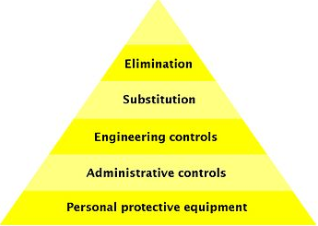
Hierarchy of Controls
Notes:
Script
ChemHAT and this training are designed to help us move up the hierarchy of controls
ASK – Does anyone recognize the hierarchy of controls?
This is how we deal with hazards in the workplace. The most effective is elimination, which means that we get rid of the hazard altogether. What do substitution, engineering controls, administrative controls, and personal protective equipment mean?

Slide 86
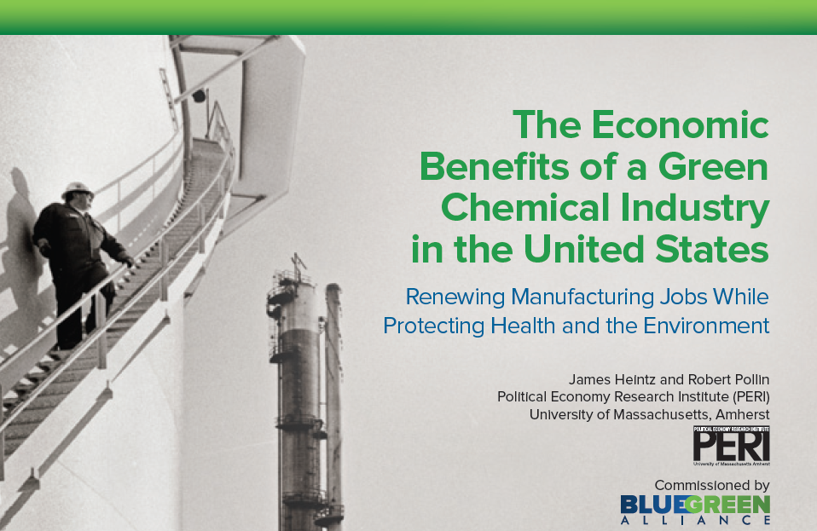
Green chemistry innovation can bring jobs back to the United States
Notes:
Script
As this study showed, moving to safer chemicals can help us bring good jobs back to the United States

Slide 87
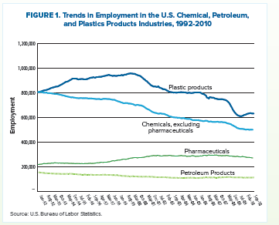
Notes:
Script
If you look at this slide you can see how jobs in the non-pharmaceutical part of the chemical industry -- what we call industrial chemicals and plastics – the top two lines have been going down steadily for the last twenty years.. Research and development has been going down as well. This report showed that stimulating innovation in the industrial chemical industry can do for that part of the industry what r and s expenditures have done for pharmaceuticals – keep people working and even added jobs here in the United States.

Slide 88





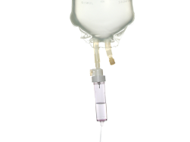



 | Decaffeinate coffee with benzene In 1970s benzene replaced with dichloromethane | Decaffeinate coffee with water or carbon dioxide
 | Manufacture IV bags and tubes using polyvinyl chloride and DEHP | Switch production to lighter, stronger polypropylene plastic that do not contain chemicals of concern and does not need a moisture overwrap
 | Produce glass for electronics using arsenic to remove air bubbles | Maintain liquid glass at higher temperature for longer periods
Notes:
Script:
Here are three examples of the kind of innovation we’re talking about (then read slide)

Slide 89

How can we start to make a change in our workplaces?
Notes:
ASK – What tools do we use to improve health and safety conditions in our workplaces?
Draw out answers like:
joint & union-only health & safety committees, contract language, complaint forms, research, surveys of our members, talking to our members, talk to OSHA/MSHA, continuous bargaining, grievances, training, union meetings, CAT Teams, OSHA 300 logs, incident and near miss reports

Slide 90


Joining the movement in our workplaces
List some examples of health and safety improvements that your local union has made in your workplace. How did you make the change?
Notes:
Presenter example:
A USW local union in Michigan surveyed their members before bargaining and found that health and safety was a major concern. The local bargained new health & safety language into their contract using the draft language from the USW International Health, Safety & Environment Department. One of the items in their contract was hazard mapping training for workers. During some of the training they found that the company’s emergency response plan was inadequate because it would take nearly an hour for the local fire department to respond. The local union health and safety committee researched the elements of good emergency response plans and worked with the management committee to re-write the emergency response plan. The union is taking the lead on building an on-site emergency response team. The local union kept the membership engaged through the entire process using a health and safety newsletter written by the health and safety committee.

Slide 91
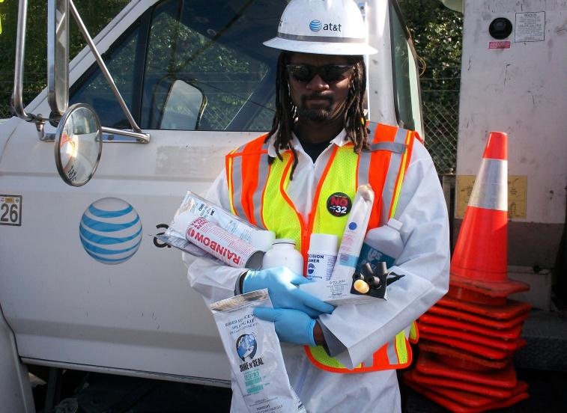
CWA District 9 is a model
Notes:
Script
This training is based in part on the work that the BlueGreen Alliance has done with CWA District 9 to first train workers and then to have these trained workers serve as the leaders of a campaign to convince AT&T to move to safer alternatives

Slide 92
Moving forward
How do we put breast cancer out of work?
Notes:
Script: So how do we do it? How do we put breast cancer out of work?

Slide 93
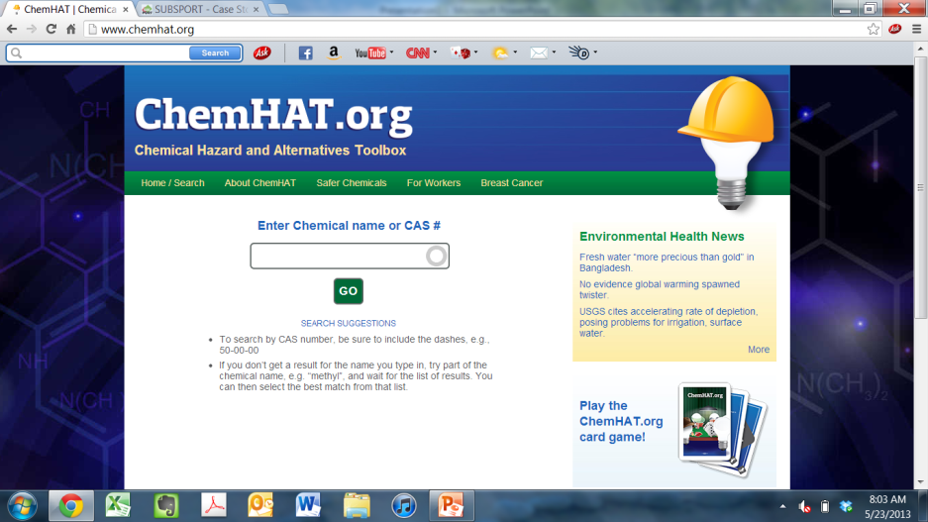
Small Group Exercise Four:
In your group, review a MSDS then look up the chemicals on ChemHAT. What did you learn?
Were there safer substitutes on Subsport?
Notes:
Script: This is the home search page for ChemHAT; you can enter either the chemical or CAS number.
Presenters Note:
Ask people to take out their smart device and their MSDS sheet, Organize people in groups of two and three to make use of the MSDS sheets and the smart phones and lap tops.

Slide 94
Exercise Four: Chemical Body Mapping Activity
For this activity at your tables you will do a specific Chemical exposure Body Map
Use the Color code on the next slide to identify the areas of the body that you are exposed at your work place.
Then explain the chemical and the process that you are doing when you are exposed. Use www.ChemHAT.org to learn more about the chemical.

Slide 96
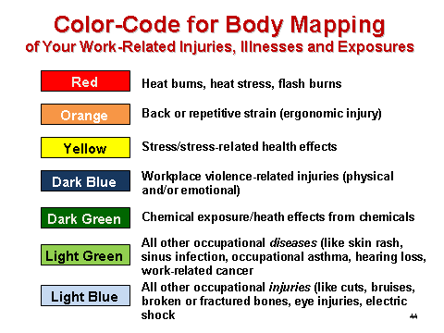
Body Mapping

Slide 97
Chemical Body Map color code
Red = Gas absorption Hazard
Yellow = Solids Dust inhalation Hazard
Blue = Liquid Absorption Hazard
Green = solids Dust contact Hazard
Orange = Other Hazard explain
Light Blue = Vapor inhalation Hazard

Slide 98
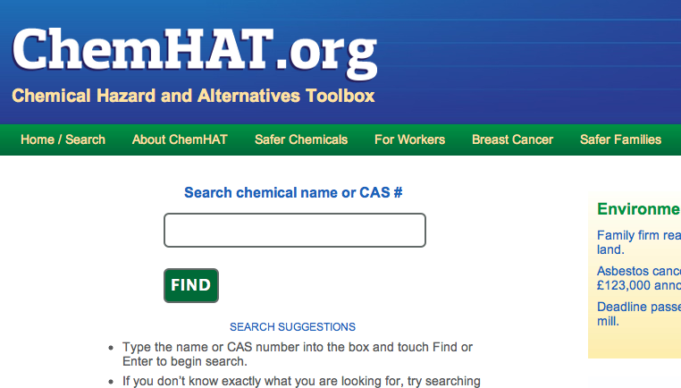
What’s Behind The Other ChemHAT tabs?
Notes:
More information about how ChemHAT work, Breast Cancer, Other ways to protect your family from dangerous chemicals

Slide 99
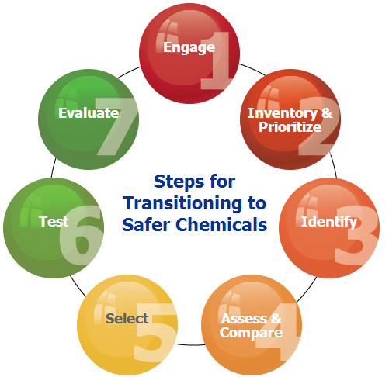
OSHA Safer Chemicals Toolkit
Compiles existing tools and methods to help employers effectively accomplish elimination and substitution
  https://www.osha.gov/dsg/safer_chemicals/
Notes:
This new OSHA toolkit provides a set of existing resources in a seven-step framework to guide employers and workers through the process of transitioning to safer chemicals, with the goal of achieving chemical use that is safer for workers and better for business. This framework is intended to provide a systematic process for understanding and evaluating chemical use, identifying and assessing alternatives, and implementing those alternatives that are safer.
It is useful to reiterate that the seven steps of the toolkit outline a process… an approach that can be used over and over again to assess the current and potential use of chemicals in the workplace. It was designed in a circular fashion for this reason.
By scrolling over the steps of the toolkit you can see the purpose of each step:
Step 1 provides information about how to establish a team and develop a work plan with safer chemical goals.
Step 2 provides tools for developing a chemical inventory and identifying targets for substitution.
Step 3 provides resources for identifying efficient, safer, and more sustainable solutions to hazardous chemicals.
Step 4 provides guidance for systematically comparing the hazard, cost, and performance of different alternatives.
Step 5 provides guidance for organizing information on hazard, cost, and performance, as well as evaluate potential trade-offs, in order to select alternatives that will improve worker safety and health.
Steps 6 and 7 provide information to help plan, evaluate, and fully implement a safer alternative.

Slide 100
Take Home Checklist
Identify potential carcinogens in your workplace
Get the MSDS to identify the chemical
Look it up on ChemHAT
If there’s a substitute on ChemHAT
  Take it to your union leadership
  Use the tools for change that we discussed earlier
Notes:
Faciltator’s Note Read this check list and discuss. Ask people to come up to the front and get their colored sheet of paper and talk about what they’re going to do when they go home.

Slide 101
Take Home Checklist, cont’d
If there is NO substitute on ChemHAT:
  Take it your union leadership
Work with the Joint Health & Safety Committee to
  Work with your employer and manufacturer to eliminate to do informed substitution for the problem chemical you’ve identified
  Introduce them to OSHA Safer Chemicals Toolkit and contact the USW Health, Safety and Environment department for more information.

Slide 102
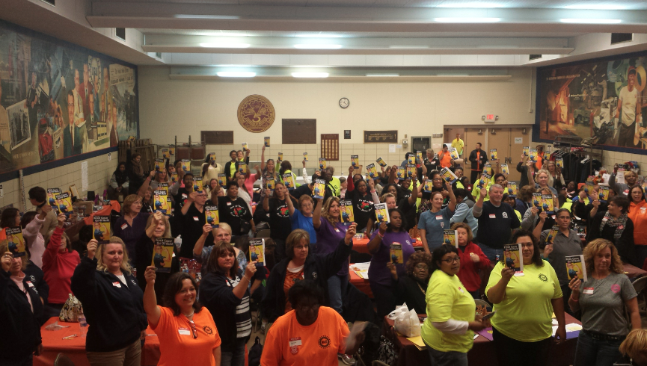

Slide 103
www.uaw.org www.ufcw.org www.usw.org www.bluegreenalliance.org www.chemhat.org www.breastcancerfund.org www.cleanproduction.org

